Slide 1

MIT-5201
By-
Jesmin Akhter
Associate Professor
Institute of Information Technology
Jahangirnagar University

Slide 2
Wireless Sensor Networks
Definition
A sensor network is an infrastructure comprised of sensing (measuring), computing, and communication elements. The results acquired by a regional network is provided to the administrator.
The administrator observe and react to events/phenomena in a specified environment. The administrator typically is a civil, governmental, commercial, or industrial entity.
The environment can be the physical world (temperature, pressure, sound), a biological system (biological and chemical sensors for national security applications for example Air pollution monitoring, Water quality monitoring) or an information technology (IT) framework.

Slide 3
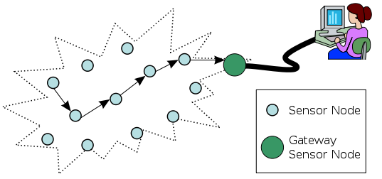
There are four basic components in a sensor network:
An assembly of distributed or localized sensors;
An interconnecting network (usually, but not always wireless-based);
A central point of information clustering; and
A set of computing resources at the central point (or beyond) to handle data correlation, event trending, status querying, and data mining.

Slide 4
Characteristics of a WSN
Self Organization
Concurrency processing
Low cost
Restricted energy resources
Tiny
Small radio range
Notes:
Characteristics

Slide 5
Applications
A wide-range of applications offered by WSN, some of these are environmental monitoring, industrial sensing, infrastructure protection, battlefield awareness and temperature sensing.
Military applications
Monitoring inimical forces
Monitoring friendly forces and equipment
Military-theater or battlefield surveillance
Targeting
Battle damage assessment
Nuclear, biological, and chemical attack detection
and more . . .
Environmental applications
Microclimates
Forest fire detection
Flood detection
Precision agriculture
and more . . .

Slide 6
Health applications
Remote monitoring of physiological data
Tracking and monitoring doctors and patients inside a hospital
Drug administration
Elderly assistance
and more . . .
Home applications
Home automation
Instrumented environment
Automated meter reading
and more . . .
Commercial applications
Environmental control in industrial and office buildings
Inventory control
Vehicle tracking and detection
Traffic flow surveillance
and more . . .

Slide 7
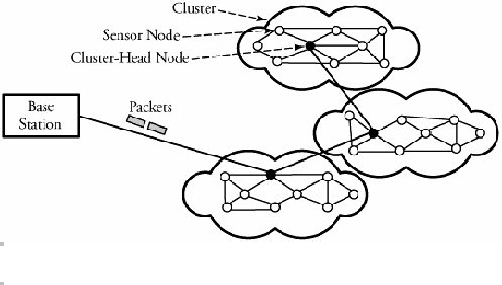
Infrastructure of Sensor Networks
The region being sensed is normally partitioned into equally loaded clusters of sensor nodes, as shown in Figure 2. A cluster in a sensor network resembles a domain in a computer network. In other words, nodes are inserted in the vicinity of a certain predefined region, forming a cluster. Different types of sensors can also be deployed in a region.
In Figure 2, three clusters are interconnected to the main base station, each cluster contains a cluster head responsible for routing data from its corresponding cluster to a base station.
Figure 2. A sensor network and its clusters

Slide 8
The wireless sensor node is equipped with a limited power source, such as a battery or even a solar cell, where there is enough sun light exposure on the node. However, a solar cell may not be the best choice as a power supply, owing to its weight, volume, and expense. In some application scenarios, sensor-node lifetime depends on the battery lifetime.

Slide 9
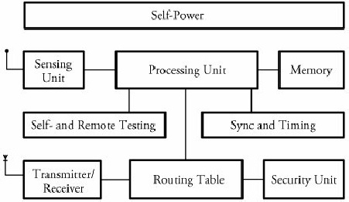
Sensor Node Structure
A sensor node consists mainly of 3 components: sensing unit, a processing unit and memory, a self-power unit.
Other supporting components are: wireless transceiver component, as well as a self- and remote-testing unit, a synchronizing and timing unit, a routing table, and security units.
Since nodes in a network are not physically accessible once they are deployed in the field, they are not worth being brought under test. An option is an on-board remote self-testing unit for the node on a routine basis
Fig.3 A typical wireless sensor node

Slide 10
Sensor Node Structure
Each node must determine its location. This task is carried out by a location-finding system based on the global positioning system (GPS).
All the processes within the sensor node are synchronized by a local clocking and synchronizing system.
The communication and security protocol units are in fact part of the processing unit. These two units are responsible for computing the best path for networking and security of the data being transmitted
Fig.3 A typical wireless sensor node

Slide 11
Sensing Unit
The sensing unit consists of a sensor and an analog-to-digital converter. A smart sensor node consists of a combination of multiple sensors.
The analog signals produced by the sensors, based on the observed event, are converted to digital signals by the converter and then fed into the processing unit.

Slide 12
Processing and Memory Unit
The processing unit performs certain computations on the data and, depending on how it is programmed, may send the resulting information out to the network.
The processing unit, which is generally associated with memory, manages the procedures that make the sensor node collaborate with the other nodes to carry out the assigned sensing task.
The central processor determines what data needs to be analyzed, stored, or compared with the data stored in memory.

Slide 13
Processing and Memory Unit
Since sensing nodes are typically tiny and many nodes are engaged in a network, the communication structure makes use of a hierarchically arranged self-routing network through cluster heads.
In smart wireless sensor networks, a tiny processor and a tiny database are used in a node. Thousands of such nodes are spread on fields to power up the sensing task, as in the deployment of numerous small intelligent sensor nodes in a battlefield to monitor enemy movements.
By inserting self-organizing capability into a sensor network, a smart node can extract data, compare it with the data stored in its memory database.

Slide 14
Self-Power Unit
A sensor node is supposed to be mounted in a small physical unit, limiting space for the battery. Moreover, the random distribution of sensors makes it impossible to periodically recharge or exchange batteries.
In most types of sensor networks, the power unit in a sensor node is the most important unit of the node because the liveliness and existence of a node depend on the energy left in the node, and the routing in the sensor network is based on the algorithm that finds a path with the least energy.
Thus, it is essential to use energy-efficient algorithms to prolong the life of sensor networks. The main task of the sensor node is to identify events, to process data, and then to transmit the data. The power of a node is consumed mainly in the transmitter and receiver unit.
The sensor node can be supplied by a self-power unit, self-power unit battery, or solar cells

Slide 15
Wireless Sensor Networks
Clustering Protocols
Clustering Protocols specify the topology of the hierarchical non-overlapping cluster nodes.
An efficient Clustering Protocol ensures the creation of clusters with almost the same radius and cluster heads that are the best positioned in the cluster.
Since every node in a cluster network is connected to cluster head, route discovery among cluster heads is sufficient to establish a feasible route in the network.

Slide 16
Classification of Clustering Protocols
Clustering techniques can be either centralized or decentralized.
Centralized clustering algorithms require each sensor node to send its individual information, such as energy level and geographical position, to the central base station. Based on a predefined algorithm, a base station calculates the number of clusters, their sizes, and the cluster heads' positions and then provides each node with its newly assigned duty.
Decentralized clustering techniques create clusters without the help of any centralized base station. An energy-efficient and hierarchical clustering algorithm can be such a way whereby each sensor node becomes a cluster head with a probability of p and advertises its candidacy to nodes that are no more than k hops away from the cluster head.
The Low-Energy Adaptive Clustering Hierarchy (LEACH) algorithm and the Decentralized Energy-Efficient Cluster Propagation (DEEP) protocol are two examples of the decentralized clustering protocols.

Slide 17
1. LEACH Clustering Protocol
The Low-Energy Adaptive Clustering Hierarchy (LEACH) is an application-specific protocol architecture that aims to prolong network lifetime by periodic re-clustering and change of the network topology.
LEACH is divided into rounds consisting of a clustering phase and a steady-state phase for data collection. At the start of each round, a sensor node randomly chooses a number between 0 and 1 and then compares this number to a calculated threshold called T(n). If T(n) is larger than the chosen number, the node becomes a cluster head for the current round. The value T(n) is calculated using the following formula:
where p is the ratio of the total number of cluster heads to the total number of nodes, r is the number of rounds, and G is a set of nodes that have not been chosen as cluster heads for the last 1/p rounds.

Slide 18
r=0:15;
p=1/16;
Tn =p./(1-p*(mod(r,1/p)));
plot(r,Tn, 'b>-')
xlabel('r')
ylabel('T(n)')
grid on
r = 0 1 2 3 4 5 6 7 8 9 10 11 12 13 14 15
T_{n} = 0.0625 0.0667 0.0714 0.0769 0.0833 0.0909 0.1 0.1111 0.125 0.1429 0.1667 0.2 0.25 0.3333 0.5 1

Slide 19
For the first round (r = 0), T(n) is equal to p, and nodes have an equal chance to become cluster head. As r gets closer to 1/p, T(n) increases, and nodes that have not been selected as cluster head in the last 1/p rounds have more chance to become cluster head.

Slide 20
After 1/p - 1 rounds, T(n) is equal to 1, meaning that all the remaining nodes have been selected as cluster head. Thus, after 1/p rounds, all the nodes have had a chance to become a cluster head once. Since being the cluster head puts a substantial burden on the sensor nodes, this ensures that the network has no overloaded node that runs out of energy sooner than the others.
After cluster heads are self-selected, they start to advertise their candidacy to the other sensor nodes.
When a node receives advertisements from more than one cluster-head, chooses the candidate whose associated signal is received with higher power. This ensures that sensor node chooses the closest candidates as cluster head.

Slide 21
2. DEEP Clustering Protocol
The Decentralized Energy-Efficient Cluster Propagation (DEEP) protocol that establishes clusters with uniformly distributed cluster heads. This protocol balances the load among all the cluster heads by keeping the clusters' radii fairly equal. This protocol is completely decentralized, and there is no need for any location-finder device or hardware.
The protocol starts with an initial cluster head and forms new cluster-head candidates gradually by controlling the relative distance between a pair of cluster heads and the circular radius of each cluster.

Slide 22
In order to avoid the frequent control signal transmission and extra power consumption associated with that, a cluster head can be placed at the center of the cluster and cluster members can send the data packets directly to the cluster head without the need for any route set-up protocol.
In order to explain the details of this algorithm, control signals and protocol parameters need to be introduced:
Control signals: (1) cluster-head declaration signal or (2) cluster-head exploration signal
Membership search signal with control parameters: declaration range (d_{r}), exploration range (d_{r1}, d_{r2}), minimum number of members (m_{n}), the received signal energy (E_{rc1} and E_{rc2}).

Slide 23
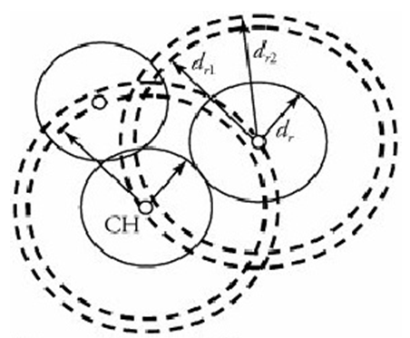
DEEP forms clusters by starting with an initial cluster head that can be chosen prior to network deployment. This initial cluster head starts the cluster set-up phase by propagating cluster-head declaration signals within the range of d_{r}. (This means that the cluster-head candidate chooses an appropriate data rate and signal output power so that it can reach nodes that are less than d_{r} away from the sender) At this point, sensor nodes that receive the declaration signal accept the corresponding cluster head as a leader.

Slide 24
Begin DEEP Clustering Algorithm
Initial cluster head finds cluster members by sending "cluster-head declaration.”
Initial cluster head finds new cluster-head candidates by sending "cluster-head exploration signal.”
Repeat: Cluster-head candidates that are placed on the (d_{r1}, d_{r2}) ring find cluster members.
Nodes that receive more than one cluster-head declaration choose the closest cluster head, based on the received signal energy.
Cluster-head candidates that receive a cluster-head declaration signal negotiate with the sender, and one of them gets eliminated.
Confirmed cluster heads send "cluster-head exploration" signals to find new cluster-head candidates(Go to step 4).
Finalize: If the number of members in a cluster is less than m_{n}, all the members find new clusters by sending the membership-search signal.
At the end, a node that has not received any control signal sends the membership-search signal.

Slide 25
Thank you

